Slide 1


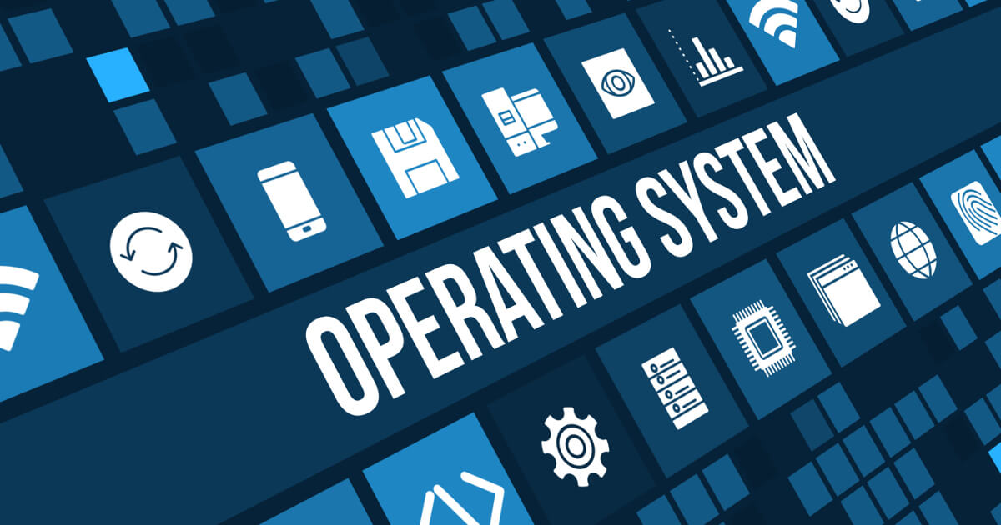
01
COMP213 · Operating Systems
Computer
System
& OS Overview
Foundational Journey Through Hardware & OS
Principles
August , 2026
Xing Zheng / Dylan

Slide 2

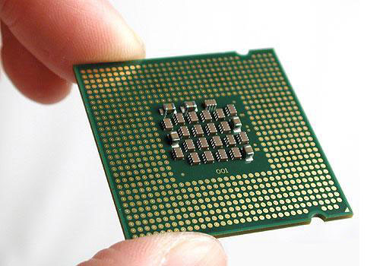
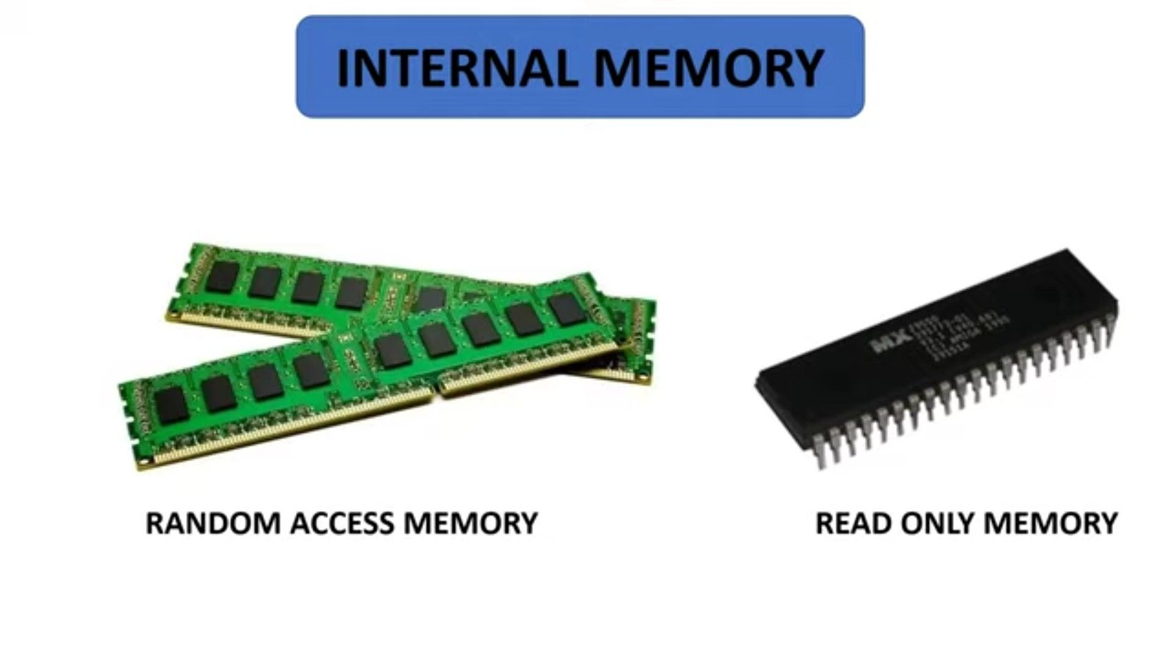
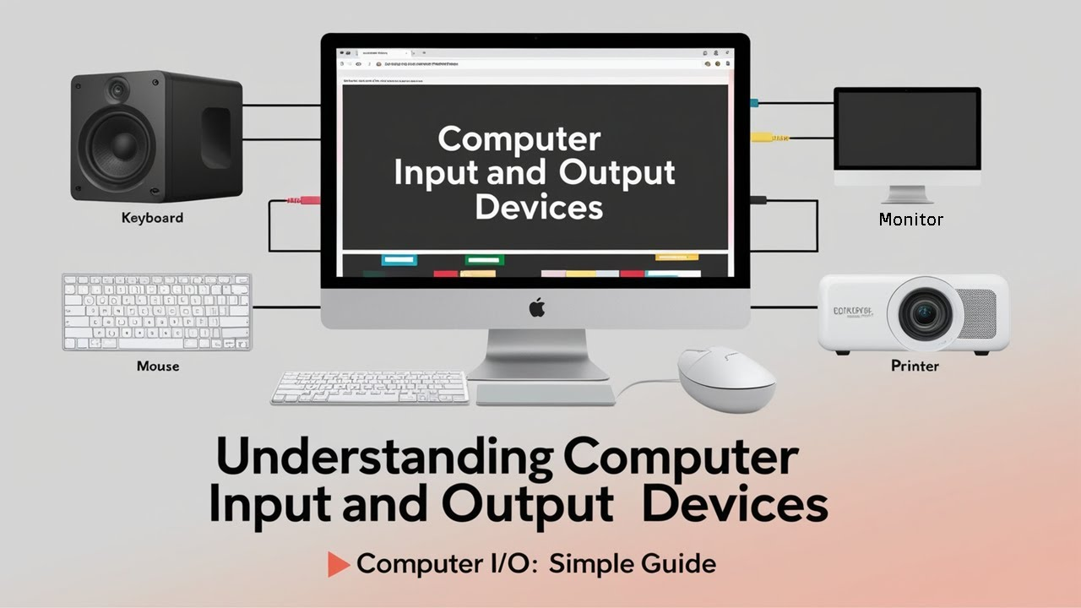
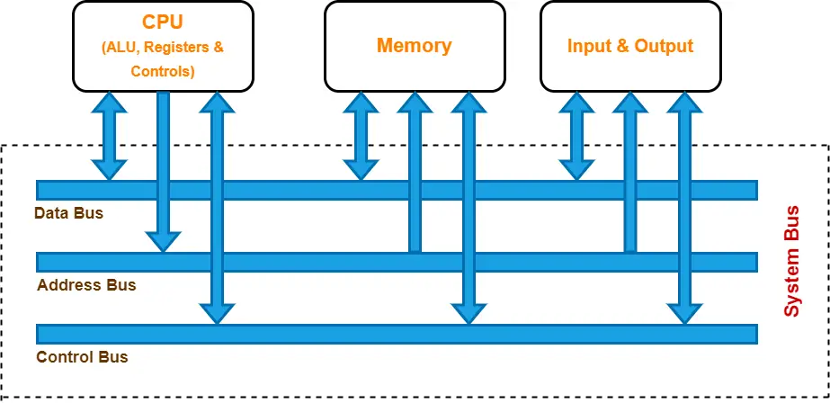
02
Chapter 1 · Computer System Overview
What is a Computer System?
A computer system has four core structural elements that work together
Processor
Memory
I/O Modules
System Bus
Controls operations and
processes data (your CPU)
Stores programs and data
temporarily while running
Connects to external
devices: keyboards, disks,
networks
The communication
highway linking all
components
4

Slide 3

03
Chapter 1 · Computer System Overview
The Basic Instruction Cycle
Every program you run follows a simple but powerful loop
Fetch
Execute
Then
Your CPU grabs the next instruction
from memory
The CPU decodes and runs that
instruction
Uses the Program Counter (PC)
Move data • Calculate • Change flow
This cycle repeats billions of times per second — keeping your computer alive and responsive!

Slide 4


04
Chapter 1 · Computer System Overview
Inside the CPU Registers
Let's look at three essential registers you'll work with
PC
IR
AC
Program Counter
Instruction Register
Accumulator
Holds the address of the next
instruction to fetch from memory
Stores the current instruction being
executed by the CPU
Temporary storage for arithmetic
operations and data
3

Slide 5




05
Chapter 1 · Computer System Overview
A Program Execution Walkthrough
Tracing how the CPU adds two values from memory: a step-by-step demonstration
01
02
03
Fetch Stage
Execute Stage
Store Result
CPU retrieves instruction from
address stored in Program
Counter (PC)
Performs operation (load, add,
store) using Accumulator (AC) as
working register
Final sum written back:
memory[940] + memory[941] →
memory[941]
mem[940]
value A
+
mem[941]
value B
=
mem[941]
SUM

Slide 6


04
Chapter 1 · Interrupts
Why Interrupts Matter
Problem
Solution
Without Interrupts
With Interrupts
The CPU delegates I/O tasks and immediately resumes
useful work
The CPU idles—wasting millions of cycles—while
waiting for slow devices like printers or disks to finish
When the device finishes, it interrupts the CPU to signal
completion
What would happen if your laptop froze every time you saved a file?

Slide 7

07
Chapter 1 · Computer System Overview
The Interrupt-Driven I/O Flow
Let's compare how your CPU handles I/O in two different ways
Program-Controlled I/O
Interrupt-Driven I/O
CPU waits idly during slow device operations
CPU continues useful work while device operates
VS
→ Wastes CPU cycles
→ Resumes when device signals completion
Which approach keeps your system more efficient?

Slide 8




08
Chapter 1 · Computer System Overview
The Enhanced Instruction Cycle
Now we add an interrupt stage to the basic fetch-execute cycle
What's New
After each execute phase, the processor
checks for pending interrupts before fetching the
next instruction
Fetch
Why It Matters
Loop
Interrupt
Decode
This simple addition lets your computer handle
urgent events (keyboard presses, disk
completion) without wasting cycles waiting
Execute
Think About It
Why do you think the interrupt check happens
after execute but before the next fetch?

Slide 9


09
Chapter 1 · Computer System Overview
Types of Interrupts
Four fundamental interrupt types that CPU handles during execution
Program
Timer
Triggered by your code—like division by zero,
illegal instructions, or accessing memory you
shouldn't
Sent by the CPU's internal clock so the OS can
run tasks regularly (e.g., scheduling)
I/O
Hardware Failure
Raised by devices to say "I'm done!" or
"Something went wrong!" after reading/writing
data
Caused by serious issues like power loss or
memory errors—rare but critical
4

Slide 10

10
Chapter 1 · Computer System Overview
Handling Multiple Interrupts
When multiple interrupts occur simultaneously, systems must decide how to manage
them
Disable Interrupts
Interrupt Priority
Temporarily ignore new interrupts while handling the
current one
Allow higher-priority interrupts to preempt lower-priority
handlers
Simple implementation
More responsive to urgent events
May miss time-critical events
Adds system complexity
Which approach would you choose for a medical monitoring system versus a basic calculator?
Computer System Overview
10 / 42

Slide 11


11
Chapter 1 · Computer System Overview
Ch1 Summary: Hardware Basics
Three fundamental concepts you must understand about computer hardware
organization
01
02
03
Four Core Components
Fetch-Execute Cycle
Interrupts
A computer has four core parts:
processor (executes instructions),
memory (stores data/programs), I/O
modules (connect to external
devices), and the system bus (links
everything)
Instructions run in a fetch-execute
cycle: the CPU fetches an instruction
(using the Program Counter),
decodes it (Instruction Register),
then executes it—often updating data
in registers like the Accumulator
Interrupts let slow I/O devices signal
the CPU without wasting cycles; the
processor pauses, runs an interrupt
handler, then resumes—keeping the
system efficient and responsive

Slide 12



12
Chapter 1 · Computer System Overview
Think About It: No Interrupts?
What would happen to system performance and
responsiveness without interrupts?
Your CPU would waste thousands of cycles waiting for slow devices like printers or
disks
The whole system would feel unresponsive—like your mouse or keyboard freezing
during file transfers
How would YOU design a better solution?

Slide 13





03
Chapter 1 · Computer System Overview
The Memory Hierarchy Concept
Memory Pyramid Structure
Fastest, smallest, most expensive (registers,
cache) at the top → slowest, largest, cheapest
(disk, tape) at the bottom
Registers
The Trade-off
Cache
As speed ↑, size ↓ and cost per byte ↑. You must
balance these factors
Main Memory
Secondary Storage
Tape / Offline Storage
Speed ↓
Size ↑
Cost ↓
Why can't we just use the fastest memory everywhere?

Slide 14



14
Chapter 1 · Computer System Overview
Why Caches Exist
Principle of Locality
Programs tend to access the same or nearby memory locations repeatedly
Temporal Locality
Spatial Locality
Accessing the same memory locations
repeatedly over time
Accessing nearby memory locations in
close succession
Recent past → Near future
Close addresses → Sequential access

Slide 15

15
Cache Memory · Performance Optimization
How Cache Memory Works
Mapping
Replacement
Write Policy
How main memory blocks are placed
in cache
Direct · Associative · Set-
associative
Which block to evict when cache is full
LRU · FIFO · Random
How writes are handled to maintain
consistency
Write-through · Write-back
3
Which policy combination would work best for a mobile device with limited battery?

Slide 16




16
Chapter 2 · Operating System Overview
Direct Memory Access (DMA)
What it is
A dedicated DMA controller handles data transfers between I/O
devices and memory—bypassing the CPU entirely
Why it matters
Frees the CPU to do useful work instead of waiting during slow,
bulk transfers (e.g., disk reads)
CPU
DMA Controller
Key benefit
Boosts system efficiency by reducing CPU overhead for large
data movements
Memory
Data Transfer
Bypassing CPU
I/O Device
Think About It
What would happen if the CPU had to copy every byte from
a hard drive?

Slide 17

17
Chapter 1 · Computer System Overview
From Single Core to Multicore
This evolution enables true parallel processing capabilities
01
02
03
Single-Core
SMP
Multicore
One processor handling all tasks
sequentially in early systems
Multiple processors sharing
memory, managed by one OS
Multiple cores on a single chip,
each acting independently
3
Discussion Question
How might software need to change to take advantage of multiple cores?

Slide 18

RECAP
Chapter 1 · Computer System Overview
Recap & Discussion Questions
Memory Hierarchy & Cache
01
Faster, smaller caches exploit locality to bridge the CPU-memory speed gap
Why can't we just use all cache instead of DRAM?
DMA & Multicore
02
DMA frees CPU from I/O data copying; Multicore chips enable parallel threads
?
?
How might DMA and multicore features interact in a real system?

Slide 19


19
Chapter 2 · Operating System Overview
What is an Operating System?
Two fundamental roles that define every OS
Resource Manager
Think About It
Allocates CPU time, memory, disk space, and I/O
devices fairly and efficiently among competing programs
What would happen if
applications could directly control
hardware without an OS?
Control Program
2
Supervises execution of user programs to prevent errors
and manage hardware access safely

Slide 20
20
Chapter 2 · Operating System Overview
Core OS Objectives
Every operating system aims to balance three key goals
01
Making the computer easy to use through clean abstractions and intuitive
interfaces
Convenience
02
Efficiency
Maximizing resource utilization (CPU, memory, I/O) without waste
03
Allowing the system to adapt and grow with new hardware and software
needs
Evolvability
Think About It
Which of these goals matters most for your smartphone's OS?

Slide 21




03
Chapter 2 · Operating System Overview
Essential OS Functions
The OS handles six core jobs to keep everything running smoothly
Process Management
Memory Management
File Management
Creates, schedules, and terminates running
programs
Allocates RAM fairly and keeps processes
isolated
Organizes, stores, and retrieves your data
reliably
I/O Management
Protection
User Interface
6
Controls communication with devices like
disks and keyboards
Enforces security rules so programs don't
interfere with each other
Provides shells or GUIs so you can actually
use the system

Slide 22

02
Chapter 2 · Operating System Overview
The OS as a Service Provider
Think of the operating system as your program's personal assistant — your code simply requests services
from the OS
Process Management
Memory Allocation
File Operations
I/O Handling
Creating and scheduling program
execution
Providing safe, isolated memory
space
Reading/writing data without
knowing disk details
Managing printers, keyboards, and
network devices
4
What would happen if every application had to manage hardware directly?

Slide 23

23
Chapter 2 · Operating System Overview
Early OS: Serial Processing
01
02
03
No Operating System
Sequential Execution
Manual Operation
Programmers worked directly with
bare metal hardware — no
software layer in between
Each program ran one after
another: load → execute → unload
before the next job
You had to manually set switches
or punch cards for every single
instruction
23
What challenges would you face if you had to operate a computer this way today?

Slide 24



02
Chapter 2 · Operating System Overview
Simple Batch Systems
01
Batch Processing
Groups similar jobs together to reduce setup time between tasks
\"
?
02
The Monitor
Think About It
Early OS automatically loads and runs the next job in sequence
How would you design a system to
handle different types of jobs fairly?
03
Improved Efficiency
Eliminates manual intervention between jobs, improving CPU
utilization
24 / 42

Slide 25


25
Chapter 2 · Operating System Overview
Multiprogramming Revolution
Multiprogramming keeps several jobs in memory at
once, so when one job waits for I/O, the CPU can
immediately switch to another ready job
Dramatically boosts CPU utilization
CPU Utilization Comparison
Single Job
CPU
I/O Wait
CPU
I/O Wait
Multi-Job
Job 1
Job 2
Job 3
Job 1
← CPU stays busy! No more idle time →
Think About It
What happens if we only run one job at a time? How much CPU time goes to waste?

Slide 26





26
Chapter 2 · Operating System Overview
Time-Sharing & Multitasking
Core Concept
Time-sharing lets multiple users interact with a
computer simultaneously by rapidly switching
the CPU between their jobs
Think About It
What would happen if the OS didn't
switch tasks quickly enough?
How slow is "too slow" for you to
feel it's unresponsive?
1
Each user gets the illusion of having exclusive machine access
2
Switching happens so fast (milliseconds!) that you won't notice
delays
3
This evolved from batch processing to enable interactive
computing
26 / 42

Slide 27

27
Chapter 2 · Operating System Overview
Modern OS Milestones
01
Microkernels
02
Multithreading
Move core services out of kernel space —
improves modularity and security
Let a single process run multiple threads —
boosts responsiveness & CPU utilization
03
SMP Support
04
Object-Oriented Design
Manage Symmetric Multiprocessors —
multiple CPUs sharing memory for scalability
Structure OS components as reusable objects
— eases maintenance & extension
Think About It
?
How might these ideas shape the OS you'll build?

Slide 28



28
Chapter 2 · Operating System Overview
Summary: OS Evolution
01
Serial Processing
No OS: Programmers ran one job at a time directly on hardware
Critical Thinking
Each step solved real
limitations. What if we
skipped
multiprogramming—could
modern apps even exist?
02
Multiprogramming & Time-sharing
OS emerged to manage resources, enable concurrency, and
support interactive use
Modern OS Foundation

Slide 29


29
Chapter 2 · Operating System Overview
Load programs into memory
Imagine This:
No
OS?
Switch between applications
Manage CPU time fairly
What if you had to manually:
Handle I/O operations directly
How would you keep everything running smoothly—without crashing?
29 / 42

Slide 30
30
Chapter 2 · Operating System Overview
Major OS Achievements
Modern operating systems solve three fundamental challenges that define computing
01
02
03
Process Management
Memory Management
Information
Protection
Creating, scheduling, and
coordinating multiple programs so
they run smoothly together
Giving each program its own
"private" memory space while
efficiently sharing physical RAM
Controlling who can access what
resources to keep the system secure
and stable
3

Slide 31


31
Chapter 2 · Operating System Overview
Process Management Basics
The operating system treats each program as a process—a unit of work that it manages
from start to finish
Creates
Schedules
Terminates
Starts a new process when you launch
a program
Decides which process runs on the
CPU and when
Ends the process cleanly when it's
done or crashes
Think About It
3
What might happen if the OS couldn't terminate a stuck process?

Slide 32


32
Chapter 2 · Operating System Overview
Memory Management Goals
Your OS needs to balance three key goals when managing memory
Isolation
Keep each process's memory separate so bugs or attacks in one
program can't affect others
Sharing
Discussion Question
Allow processes to safely share memory when needed (like
shared libraries)
How would you design a system that
achieves all three goals at once?
Efficient Usage
3
Make the most of limited RAM by using techniques like virtual
memory

Slide 33


03
Chapter 2 · Operating System Overview
Virtual Memory Concept
What Process Sees
Virtual Address Space
Address Space Illusion
Each process gets its own huge, private address space
—even when physical RAM is limited
Each process believes it has its own huge, private memory
Address Translation
OS Maps Behind the Scenes
OS maps virtual addresses (used by programs) to
physical addresses (in real memory)
Physical Reality
Process Isolation
Physical Memory (RAM)
Every process gains isolation and the feeling of
abundant memory
Limited hardware memory shared by all processes
How would programs behave if they shared one global address space?
33 / 42

Slide 34

34
Chapter 2 · Operating System Overview
Information Protection & Security
Access Control
Protected Space
Permissions
Mechanisms decide who can use what
resources
Each process runs in isolation – you
can't mess with others' data
The OS enforces read, write, execute
– like digital locks on files
How would your phone feel if any app could read your messages or delete photos?
3

Slide 35






35
Chapter 2 · Operating System Overview
Scheduling Fundamentals
The OS uses a scheduler to decide which ready process gets the CPU next — like a traffic cop
managing flow through an intersection
1
The Scheduler
Scheduling Flow
A critical OS component that selects which process in the ready queue gets CPU time next
Ready Queue
P1
P2
P3
P4
2
Ready Queue
Maintains all processes waiting for CPU — without scheduling, only one program runs at a
time
Scheduler
3
Scheduling Algorithms
Apply fair and efficient decision-making rules to allocate processor time among competing
processes
CPU
35
Critical Thinking
How would you design a fair system if you had to choose between urgent tasks and long-running computations?

Slide 36


36
Chapter 2 · Operating System Overview
System Generation (SYSGEN)
When does SYSGEN happen?
What is SYSGEN?
01
Installing an OS on new hardware
System Generation is the process of
customizing and configuring an operating system
for a specific computer's hardware setup
02
The OS needs to recognize your exact CPU, memory, and
devices
03
Drivers and kernel modules are selected based on your system
Think About It
What might go wrong if an OS skips proper SYSGEN for your laptop?

Slide 37

03
Chapter 2 · Operating System Overview
Key Concepts
Four pillars that define modern operating systems
Processes
Memory
The OS manages programs as processes—isolated units of
execution with their own state and resources
Virtual memory gives each process the illusion of a large,
private address space, even on limited physical RAM
Protection
Scheduling
4
Hardware and OS mechanisms enforce access control,
ensuring processes can't interfere with each other or the kernel
The scheduler decides which ready process runs next,
balancing fairness, responsiveness, and throughput
How do these four pillars work together to make multitasking feel seamless?

Slide 38

02
Chapter 2 · Operating System Overview
Puzzle This: Resource Sharing
How can the OS safely allow multiple processes to share the same printer?
01
Should processes send print jobs directly to the printer?
02
What could go wrong if two processes print simultaneously?
03
Could we use a queue to manage print requests?
04
What role does the OS play as a resource manager here?
38 / 42

Slide 39

39
Chapter 2 · Operating System Overview
OS for Multiprocessor Systems
In SMP (Symmetric Multiprocessor) and multicore systems, the OS faces three key
challenges
Scheduling
Synchronization
Memory Management
The OS must distribute processes
across multiple CPUs fairly and
efficiently
Shared resources need careful
coordination to avoid race conditions
Ensures cache coherency and efficient
memory access across cores
3
How would you design a scheduler that balances load while minimizing inter-core communication
overhead?

Slide 40


40
Chapter 2 · Operating System Overview
Modern OS Characteristics
Three key architectural innovations that define modern operating systems
Microkernel
Architecture
Multithreading
Object-Oriented Design
Lets a single process have multiple
threads of execution, improving
responsiveness and enabling efficient
use of multicore CPUs
Treats system resources (files,
devices, processes) as objects with
defined interfaces—making the OS
more modular, reusable, and easier to
extend
Keeps the kernel minimal—only
essential services (like IPC) run in
kernel mode. Everything else (drivers,
file systems) runs as user-space
processes for better stability and
security
3

Slide 41

41
Chapter 1 & 2 · Summary
Final Recap: From Hardware to OS
The operating system transforms raw hardware complexity into usable abstractions
01
02
03
Raw Hardware
OS as Bridge
Why It Matters
Your computer's hardware (CPU,
memory, I/O) is raw and complex—but
the OS hides this complexity through
abstraction
Think of the OS as a bridge: it turns
physical resources into easy-to-use
services like processes, virtual
memory, and files
Without these abstractions, you'd
manage every register, interrupt, and
memory address yourself—imagine
coding that!
OS

Slide 42


42
Chapter 2 · Operating System Overview
Let's Discuss & Explore!
Open questions for further exploration and critical thinking
Question 02
Question 01
Question 03
Where do you think operating systems
will evolve next as hardware keeps
changing?
What if we redesigned
interrupts for today's multicore
systems—how would you
approach it?
If you were building an OS from
scratch today, what would be
your top priority?
?
千问AI生成

